Slide 1
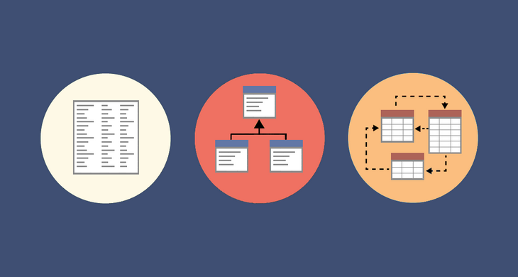
Warehouse and analytical build
Practical

Slide 2
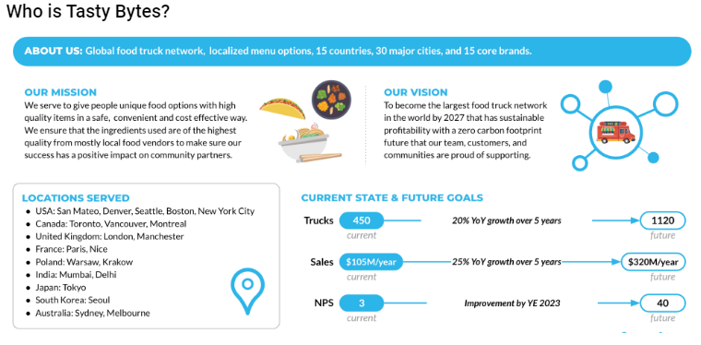
About the company

Slide 3
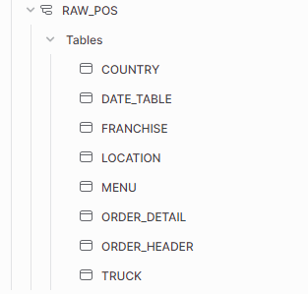

Lets look at their Data
Tasty bites has two schema’s that we are interested in. The Raw POS Schema and the Raw Customer Schema.

Slide 4
Lets explore the data
Lets have a look at what data exists in each of those tables, lets spend some time analysing the tables, spot how the tables relate to each other so we can have a holistic view.

Slide 5
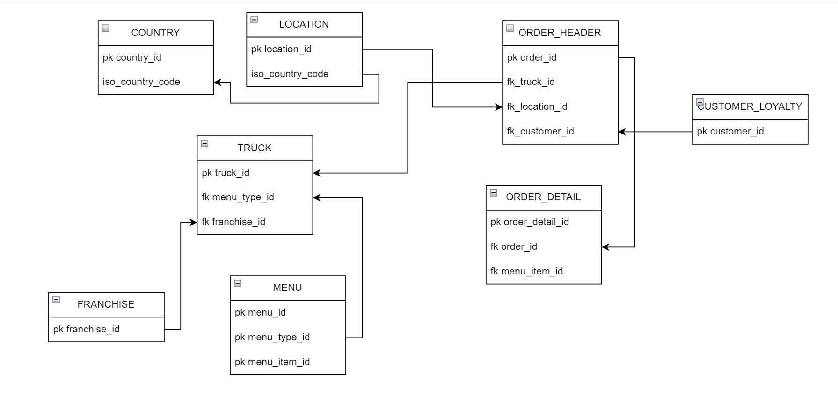
An ERD built after analysing the data

Slide 6
Questions?

